Slide 1
Types of Algorithms

Slide 2
Basic Steps of the complete development of an algorithm

Slide 3
1- Statement of the problem
Development of a model
Design of an algorithm
Correctness of the algorithm
Implementation
Analysis and complexity of the algorithm
Program testing
documentation

Slide 4
Statement of the problem
1 Do I understand the vocabulary used in the raw formulation?
What information has been given?
What do I want to find out?
How do I recognize a solution?
What information is missing.and will any of this be of use?
Is any of the given information worthless?
What assumptions have been made?

Slide 5
Development of a model
Which mathematical structures seem best-suited for the problem?
Are there any other problems that have been solved which resemble this one?

Slide 6
Documentation
Golden rule:
Document your program the way you want others to document the program which you read

Slide 7
(divide and conquer)
this technique divides a given problem into smaller instances of the same problem, Solves the smaller problems and combine solutions to solve the given problem.
(b) Greedy algorithm: An algorithm which always takes the best immediate or local solution while finding the answer. Greedy algorithms will find the over all or globally optimal solution for some optimization problems but may find less than optimal (suboptimal solutions) for some. These algorithms are very easy to design.

Slide 8
( c ) Dynamic programming Algorithm: It solves sub problems just once and save the solutions in a table. The solution will be retrieve when the same problem is encountered later on.
Back tracking algorithm: An algorithmic technique by trying one of the several possible choices. If the choice proves incorrect, computation backtracks or restarts at the point of choice and tries another choice.
Brach and bound: it is similar to backtracking.In backtracking we try to find one or all configurations modeled as n- tuples which satisfy certain properties.Branch and bound algorithms are oriented more toward optimization. Here a bounding function is developed to prove incorrect choice.

Slide 9
Approximate algorithm: An algorithm to solve an optimization problem that runs in polynomial time in the length of input and outputs the a solution that is guaranteed to be close to the optimal solution.
Randomized algorithm :An algorithm is randomized if some of the decisions depend upon the output of a randomizer. A randomized algorithm is said to be Las Vegas algorithm If it always produce the same correct output for the same input. If the output differs from run to run for the same input we call it Monte Carlo algorithm.

Slide 10
(h) Genetic Algorithm: It is an effective method for optimization problems.It was introduced by J.H.Holland in 1975..It manipulates bit strings analogously to DNA evolution. Here we represent a possible solution as a chromosome. This technique creates a population of chromosome and applies genetic operators such as mutation and crossover to evolve the solutions in order to find the best.

Slide 11
(i) Parallel algorithm: A parallel algorithm is an algorithm that has been specially written for execution on a computer with two or more processors.

Slide 12
Divide and conquer algorithms

Slide 13
The divide and conquer paradigm involves three steps:
Divide the problem into a number of smaller problems
Conquer the sub problems recursively.
Combine the solutions into the solution for the original problem.

Slide 14
Merge sort closely follows the divide and conquer approach as
Divide:divide the given n element sequence to be sorted into two subsequences of n/2 size each
Conquer: sort the two subsequences recursively using merge sort.
Combine: merge the two sorted subsequences to produce the sorted array as final answer.

Slide 15
The procedure merge sort sorts the elements in the sub array A[low,high].
If low≥high the sub array has at most one element and is therefore already sorted.
Otherwise we divide it into A[low,mid] and array[mid+1..high]
Merger sort(A,low,high)
if low <high
Then mid←[(low+high)/2]
merge sort(A,low,mid)
merge sort(A,mid+1,high)
merge (low,mid,high)

Slide 16
Algorithm Merge (low,mid,high)
{
h:= low; i:=low; j:=mid+1;
while((h ≤ mid) and (j ≤ high)) do
{
if (a[h] ≤ a[j] then
{
b[I]:= a[h]; h:=h+1;
}
Else
{b[I]:=a[j];j:=j+1;
}
I:=I+1;
}

Slide 17
If(h> mid) then
for k:=j to high do
{
B[I]:=a[k];I:=I+1;
}
Else
for k:= h to mid do
{
B[I] :=a[k]; I:= I+1;
}
For k:= low to high do a[k]:= b[k];
}
Time for merging is proportional to n.

Slide 18
Analyzing divide and conquer algorithms
Total time of an algorithm based on divide and conquer approach is based on three timings:
Let T(n) be the running time on a problem of size n. If the problem size is small straight forward solution takes constant time say θ(1).
Suppose we divide the problem into a number of sub problems each of size 1/b the size of original.
If it takes D(n) time to divide the problem into sub problems and
C(n) time to combine the solutions into the solution of original problem,we get the relation as:

Slide 19
T(n) = θ(1) if n ≤ c
= a T(n/b) + D(n) +C(n) otherwise
For merge sort:
D(n) = θ(1); C(n) = θ(n)
And we divide the problem into two of size half so

Slide 20
T(n) = θ(1) If n=1
= 2 T(n/2) + θ(n) if n >1

Slide 21
Recurrence
A recurrence is an equation or inequality that describes a function in terms of its value on smaller inputs.For example:
T(n) = θ (1) if n = 1
      =2 T(n/2) + θ(n) if n >1
      There are three main methods to solve –that is for obtaining asymptotic θ or O bounds on the solution.

Slide 22
Iteration method(expansion method)
Substitution method
Master method

Slide 23
Iteration method
Idea is to expand(iterate) the recurrence and express it as a summation of terms depending only on n and the initial conditions.
Ex
T(n) = k + T(n/2) if n>1
      = c if n=1

Slide 24
T(n) = k + T(n/2)
T(n/2) = k + T(n/4)
T(n) = k + k+ T(n/4)
Repeating this process we get
T(n) = k + k + k + T(n/8)
And repeating over and over we get
T(n) = k + k+ … K + T(1)
= k + k+ … K + c
How many k’s are there? This is no. of times we can divide n by 2 to get down 1 that is log n.Thus
T(n) + (log n)*k + c where k and c are both constants
Thus
T(n) = O(log n)

Slide 25
Substitution
It involves guessing or informally recognizing the proper answer, then using proof by induction to prove it formally.
Example:
T(n) = k + T(n/2)
Based on some mysterious prompting from our subconscious, we might hypothesize that
T(n) = O(log n)

Slide 26
base T(1) = c constant(log 1)+c’
Inductive assumption: Assume that
T(I) <= cons*(log I) +c for all I <n
Now consider T(n) = k + T(n/2)
Since n/2 is less than n we can use assumption
T(n) <= k + cons *(log n/2 ) + c
i.e.

Slide 27
T(n) <= k + cons * (( log n) – 1) + c
< = k – cons + cons * (log n ) + c
Now what we need to show is that T(n) <= cons(log n) + c’
If we choose cons = k
T(n) <= cons * log(n) +c
Which is exactly what we wanted

Slide 28
Master method
Master method provides a ‘cook book’ method for solving recurrences of the form
T(n) = aT( n/b) + f(n)
Where a >= 1 and b >1 are constants and f(n) is an asymptotically positive function.
It describes the running time of an algorithm that divides a problem of size n into a sub problems each of size n/b where a and b are +ve constants.

Slide 29
The cost of dividing the problem and combining the results of the sub problems is described by the function f(n).

Slide 30
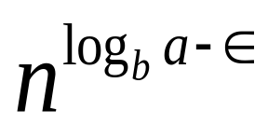
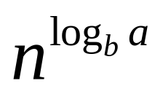
Master theorem
Let a >= 1 and b>1 be constants, let f (n) be a function, let T(n) be defined on non negative integers by the recurrence
T(n) = a T(n/b) + f(n)
Where we interpret n/b to mean either ceiling of(n/b) or floor of(n/b).Then
T(n) can be bounded asymptotically as follows:
if f(n) = O( )
For some constant ε>0, then T(n) = θ(
)

Slide 31
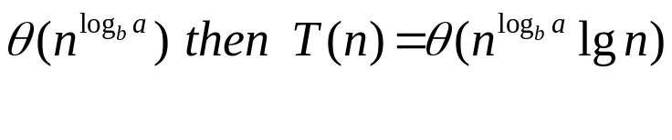
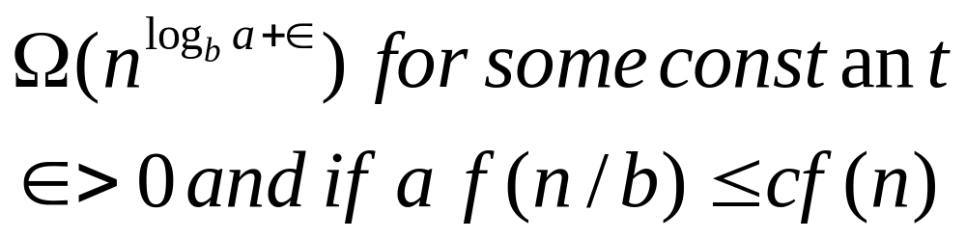
2. If f(n) =
If f(n) =
For some constant c < 1 and all sufficiently large n, then T(n) = θ(f(n))

Slide 32
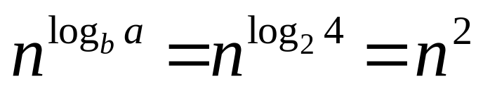
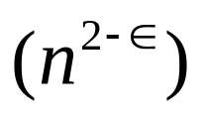
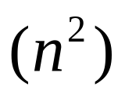
example
T(n) = 4 T(n/2) + n
Here a = 4, b = 2, f(n) = n
so
Case 1 since for ε = 1 , f(n) is O
i.e. T(n) = θ

Slide 33
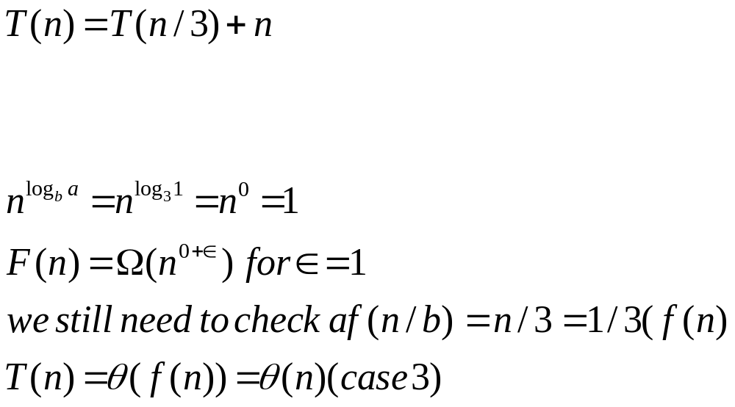

Slide 34
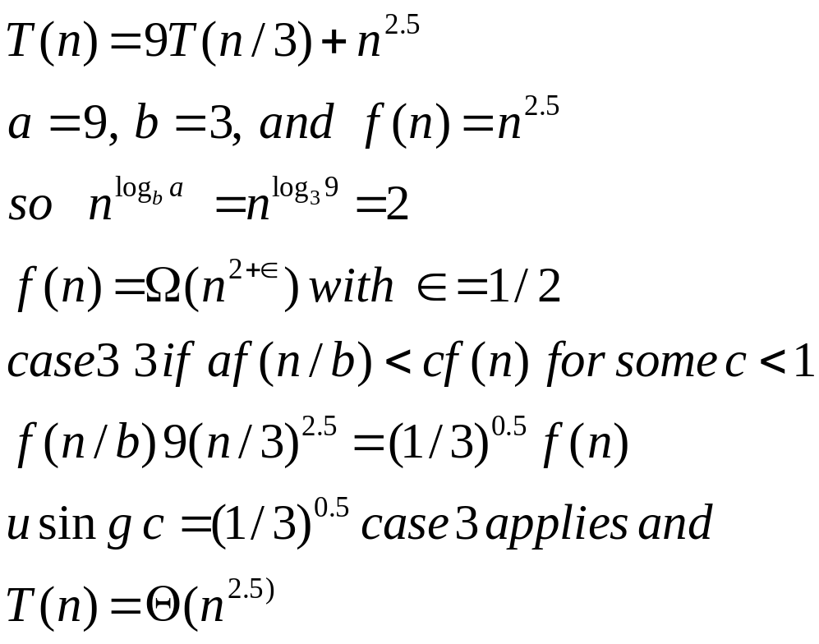
Ex

Slide 35
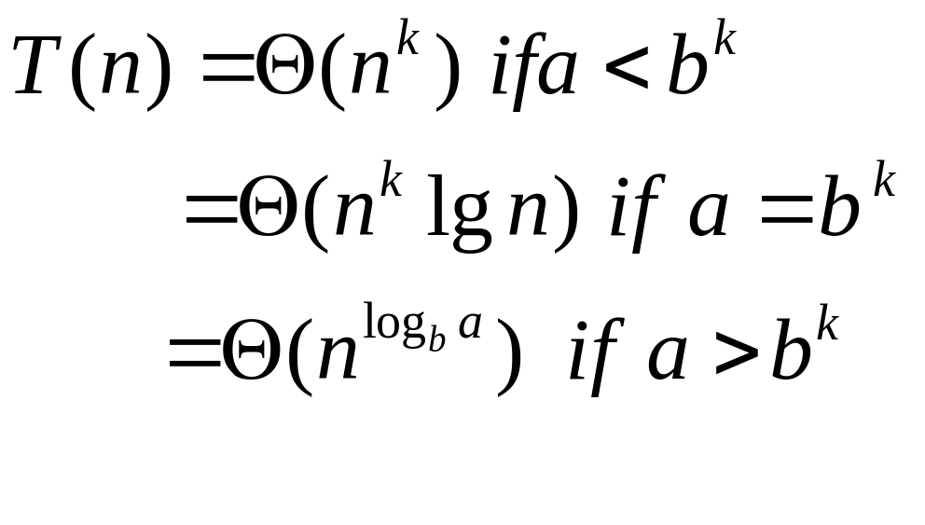
Suppose T(n) = aT(n/b) + cn^{k} for n>1 and n a power of b
T(1) = d
Where b >= 2 and k>=0 are integers a>0, c>0 d>= 0
Then

Slide 36
A tricky example
T(n) = 2*T(sqrt(n)) + log n
This can not be solved with the master theorem since sqrt(n) does not match the n/b pattern.
One way to simplify this problem is to replace n by another variable which is defined as a function of n
For example suppose let
M = log n
Or
N = 2**m

Slide 37
Thus
T(2**m) = 2*T(sqrt(2**m)) + m
        = 2*T(2**(m/2)) +m
        Now simplifying further by defining S(x) == T(2**x)
S(m) = 2*S(m/2) +m
So S(m) = O(m*log m)
T(2**m) = O(m* log m)
Or finally
T(n) =O((log n)*log(log n))

Slide 38
Tower of Hanoi
{// replace all the n plates from peg1 to peg3 using peg2
Hanoitower(peg1, peg3,peg2,n-1)
//replace first n-1 plate from peg1 to peg2 using peg 3
Hanoitower(peg1, peg2, peg3, 1)
Hanoitower(peg2, peg1, peg3, n-1)
}
M(n) = 2M(n-1) + 1
We can not use master theorem directly.
A trick called reparameterization can be used
As: m =b ^{n} for some fixed base b and exponential parameter m.
M(n) = M(log _{b} m) = M’(m) so
M’(m) = M(log _{b} m)
= M(n)

Slide 39
Tower of Hanoi
^{= 2M(n-1)+1}
^{=2M’(m/b)+1}
^{Now} we can use master theorem
As
A=2 ; f(n) = n ⁰
^{So}
^{M’(m) = Θ(}_{m} ^{log} _{b} ^{2)=Θ(2 ** log} _{b} ^{m)} = ^{Θ (2**n)}

Slide 40

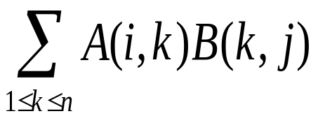
.Strassen’s matrix multiplication
Let A and B be two n by n matrices.
The product C = AB cab be obtained as
C(i,j) =
For all i and j between 1 and n.
To compute C(I,j) we need n multiplications.As C has n*n elements we can say matrix multiplication algorithm is θ(n cube)

Slide 41
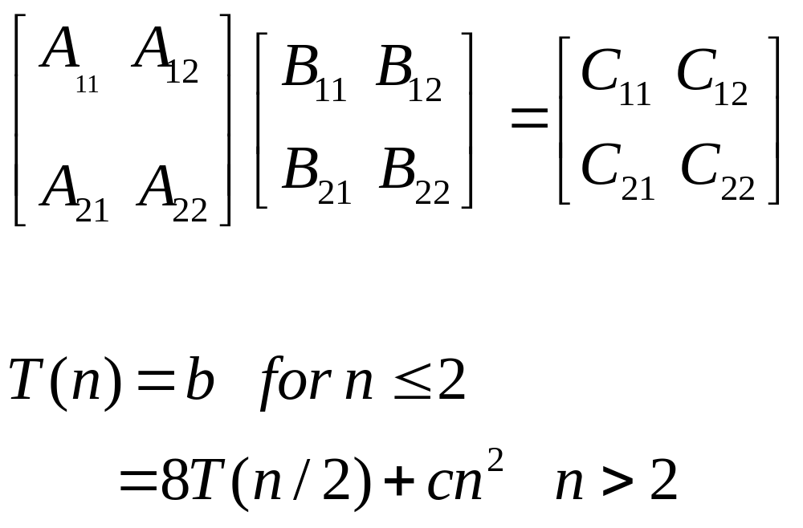
Let us use divide and conquer approach as
b and c are constants
Solving it comes out
T(n) = O(n*n*n) hence no improvement.

Slide 42
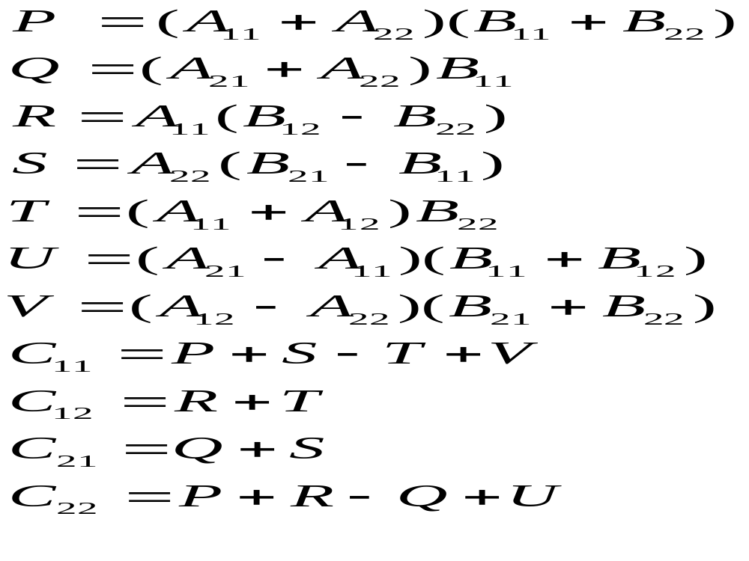
However if we do it like

Slide 43
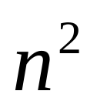
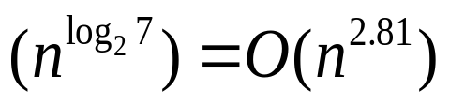
T(n) = b for n<=2
    = 7 T(n/2) +a
For n >2
Where a and b are constants.
Solving it
T(n) = O

Slide 44
The problem of multiplying long integers
X,Y two n-bit integers.
Simple multiplication is O(n ²) algorithm counting single bit or digit multiplication as one step.
X:
A B
X = A 2 ^{n/2} + B
Y = C 2 ^{n/2} + D
Y:
C D
XY = AC 2 ^{n} + (AD +BC )2 ^{n/2} +BD

Slide 45
Four multiplications of n/2 bit integers (AC,AD,BC and BD) three additions with at most 2n bits (corresponding to three + signs) and two shifts (multiplications by 2 ^{n} and
2 ^{n/2}). As these additions and shifts take O(n) steps ,we can write recurrence relation for it as:
T(1) = 1
T(n) = 4 T(n/2) + cn
Solving it
T(n) is O(n ²)

Slide 46
Which is no improvement over ordinary method.
We can get asymptotic improvement if we decrease the number of sub problems.
XY = AC2 ^{n} +[( A-B)(D-C) + AC + BD]2 ^{n/2} + BD
It requires only three multiplications of n/2 bit integers AC , BD, and (A-B)(D-C) , six additions or subtractions and two shifts.
All but multiplications take O(n) steps the time T(n) is given as:

Slide 47
T(1) = 1
T(n) = 3 T(n/2) + cn
Solution is T(n) O( n ^{log} ₂ ³ ) = O( n ^{1.59})

Slide 48
Quick Sort
Recursive quick sort(A, LB, UB)
If LB <UB
Then
I=LB
J=UB +1
Key =A[LB]
Repeat
1 repeat
i =i+1
Until(A[i]> = k)
2 repeat
j = j-1

Slide 49
    Until(A[j]< =k)
    3 If(i<j) hen interchange (A[i];A[j])
    Until(i= j)
    Interchange(A[LB],A[j])
    Call recursivequicksort(A , LB , j-1)
    Call recursivequicksort(A , j+1 , UB)
    return

Slide 50
Time Analysis
T(n) = P(n) + T(j-lb) + T (ub - j)
Where
P(n) = time to partition the given file
Best Case:
When file is always divided in half.
T(n) =P(n) +2 T(n/2)
= c n + 2T(n/2)
Solving
T(n) = O(n log ₂ n)

Slide 51
Worst case
T(n) = P(n) + T( 0) + T( n-1)
= c.n + 0 + T(n-1)
= c.n + c.(n-1) + T(n-2)
= c.n + c.(n-1) + c.(n-2) + T(n-3)
.
.
= c (1+2+3+ n) + T(0)
= c.n.(n+1)/2
= O(n ²)

